Slide 1

Note: The data and information in this document is reflective of a hypothetical situation and client. This document is to be used for KPMG Virtual Internship purposes only.
Sprocket Central Pty Ltd
Data analytics approach
Omkar Pawar, Junior Consultant

Slide 2
Note: The data and information in this document is reflective of a hypothetical situation and client. This document is to be used for KPMG Virtual Internship purposes only.
Agenda
Introduction
Data Exploration
Model Development
Interpretation

Slide 3
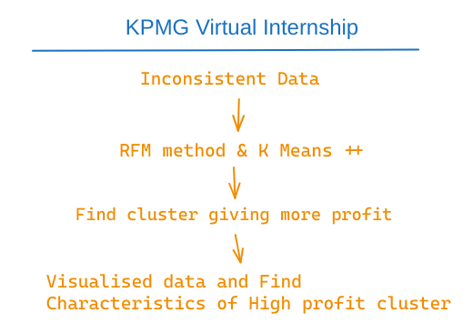
Note: The data and information in this document is reflective of a hypothetical situation and client. This document is to be used for KPMG Virtual Internship purposes only.
Introduction
Task: Find target customers from new list using previous DATA
1. Clean data and remove inconsitencies
2. Use Recency, Frequency and Monetary Method to find profit generating customers
Place any information about this point here.
3. Use K Means Clustering to seprate customers in to different clusters.
4. Take the High profit generating customers cluster and Find there characteristics
5. Use these charcteristics to filter out customers from new list

Slide 4
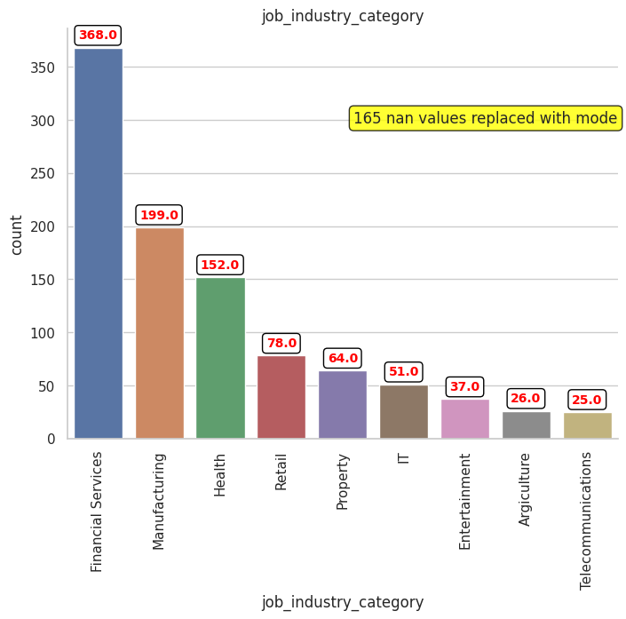
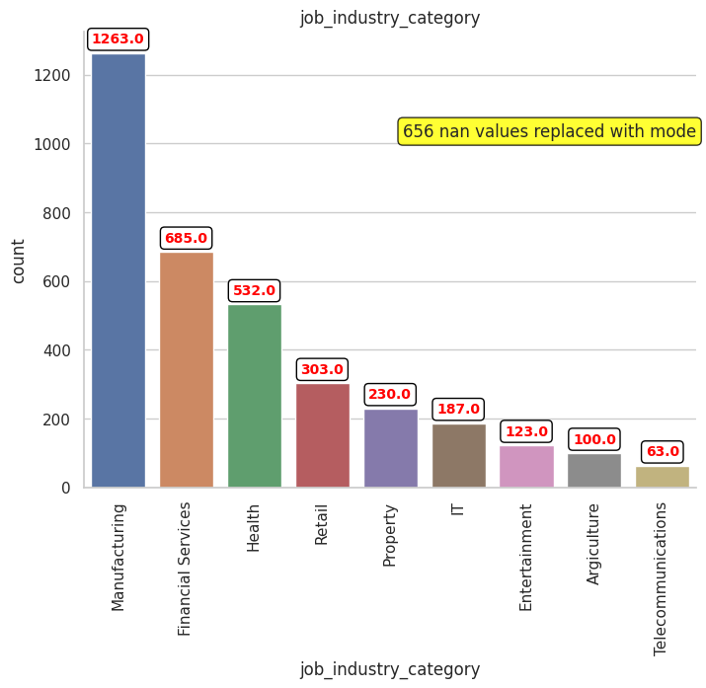
Note: The data and information in this document is reflective of a hypothetical situation and client. This document is to be used for KPMG Virtual Internship purposes only.
Data Exploration
Job Industry
- We have more buyers from
1. Manufacturing
2. Financial Serviecs
3. Health
Old
New

Slide 5
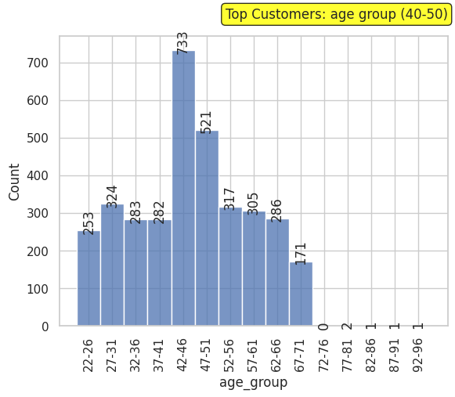
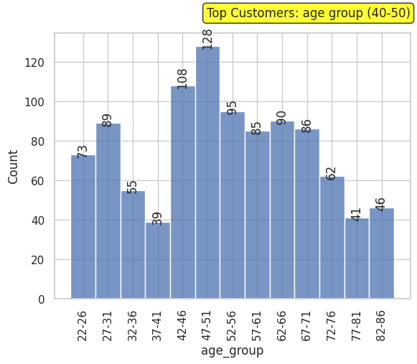
Note: The data and information in this document is reflective of a hypothetical situation and client. This document is to be used for KPMG Virtual Internship purposes only.
Data Exploration
Age
1. Majority of customers are between age of 40 – 50.
2. In new customers there is rise in customers between age of 20 to 30.
Old
New

Slide 6
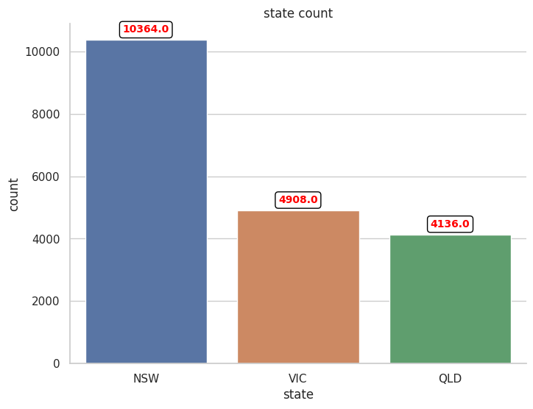
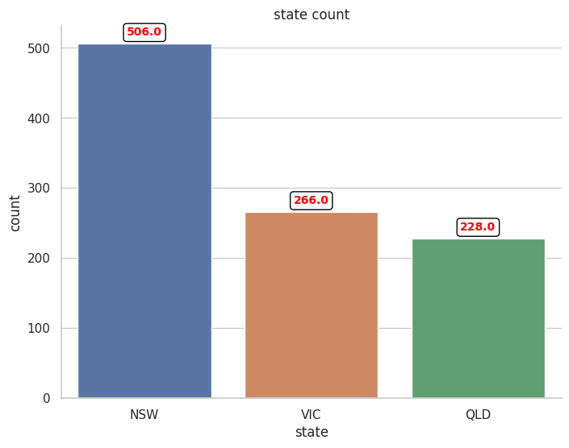
Note: The data and information in this document is reflective of a hypothetical situation and client. This document is to be used for KPMG Virtual Internship purposes only.
Data Exploration
State
1. Majarity of customers are from NSW.
Old
New

Slide 7
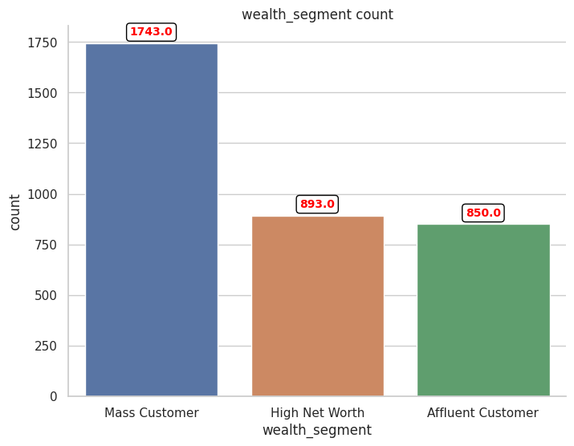
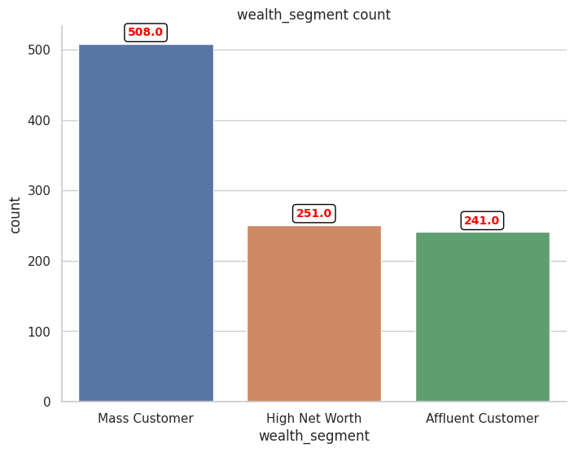
Note: The data and information in this document is reflective of a hypothetical situation and client. This document is to be used for KPMG Virtual Internship purposes only.
Data Exploration
Wealth Segment
1. Mass customers are generating more revenue.
New
Old

Slide 8
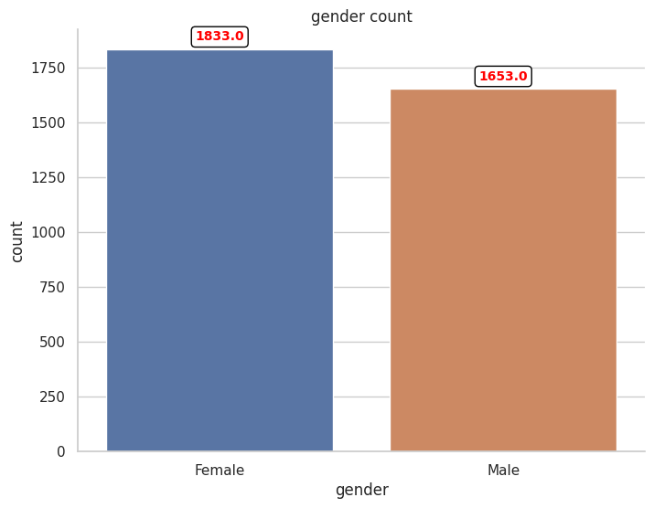
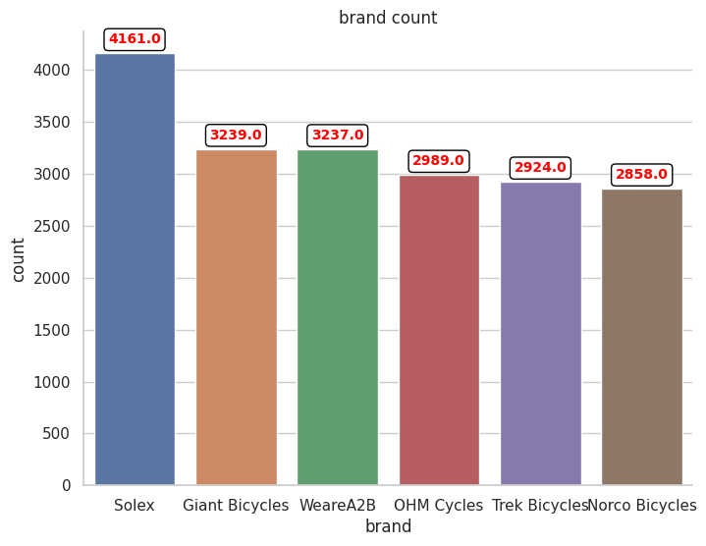
Note: The data and information in this document is reflective of a hypothetical situation and client. This document is to be used for KPMG Virtual Internship purposes only.
Data Exploration
Gender
1. Females are slightly buying more
bikes compared to males. Difference is negligible.
Brand
1. Solex is the most sold bike.
2. Other brands contribute to sell in almost same maner.

Slide 9
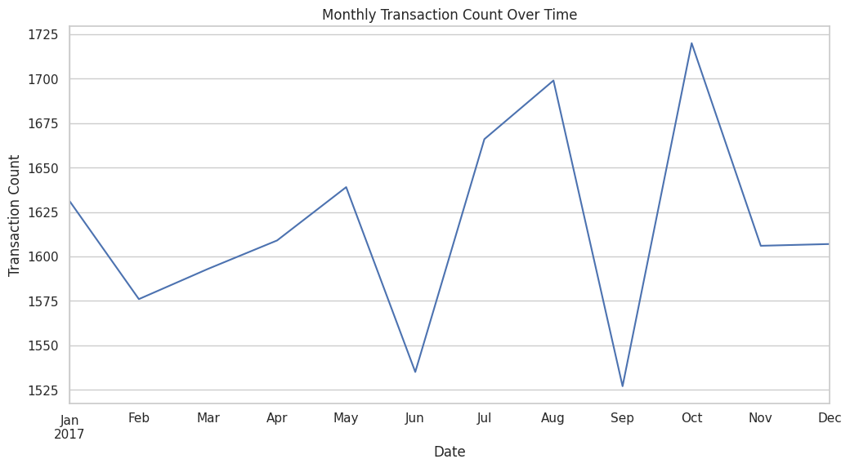
Note: The data and information in this document is reflective of a hypothetical situation and client. This document is to be used for KPMG Virtual Internship purposes only.
Data Exploration
Transactions Over Time
Old customers Transactions
1. August and Octomber are peak months for bike purchase.
2. There is comparitively less sales in june and september month.

Slide 10
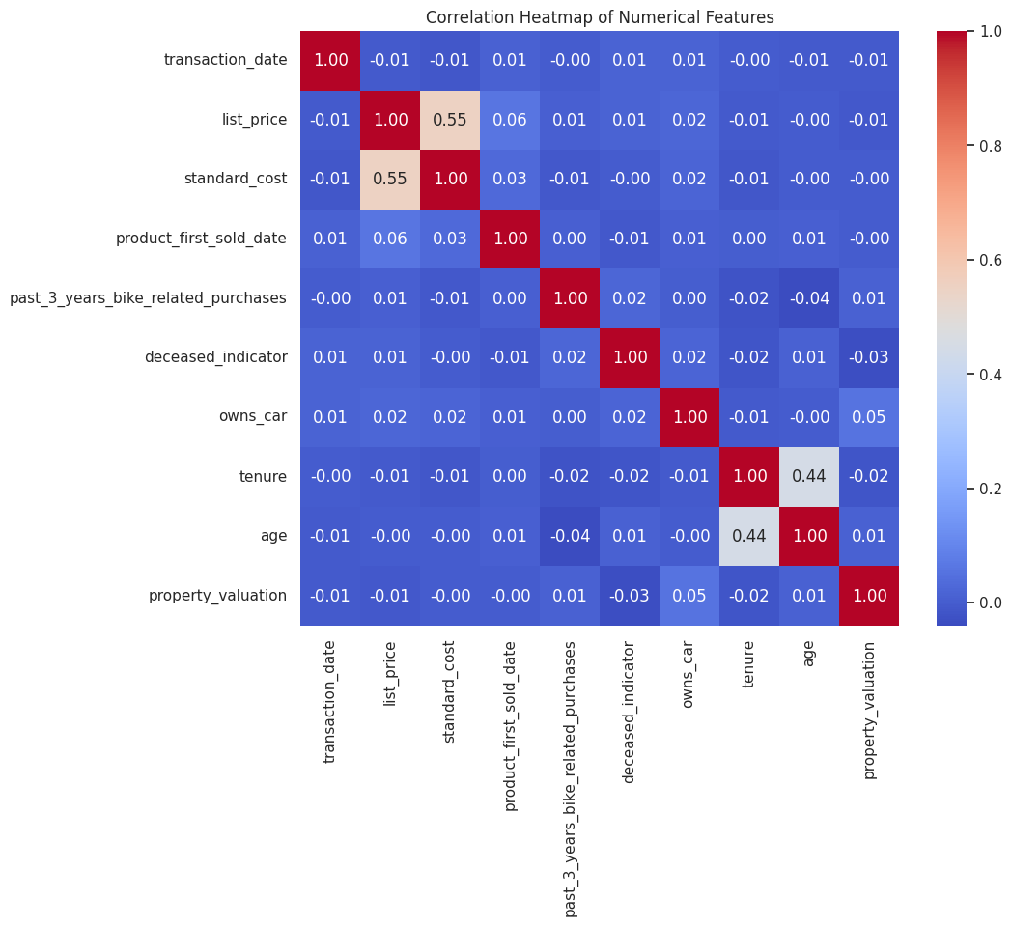
Note: The data and information in this document is reflective of a hypothetical situation and client. This document is to be used for KPMG Virtual Internship purposes only.
Data Exploration
Transactions Over Time
Correlation between features
1. There is slightly positive correlation between age and tenure. People
of the older brackets have a longer tenure.

Slide 11
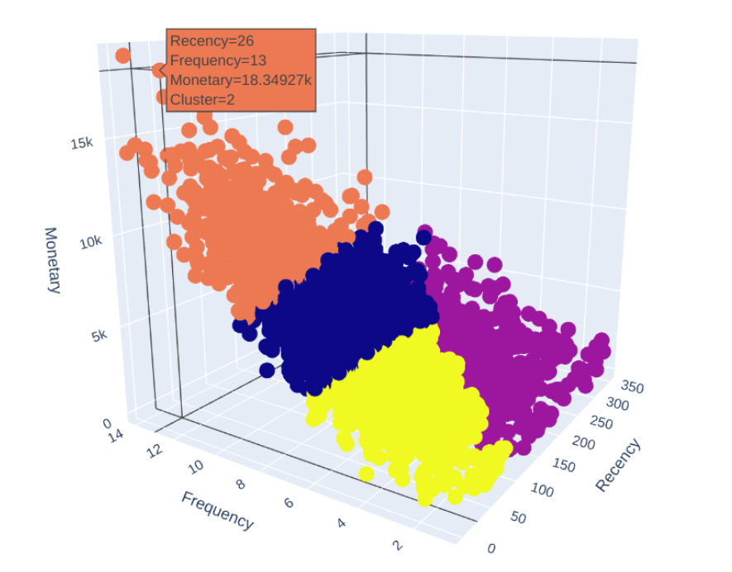
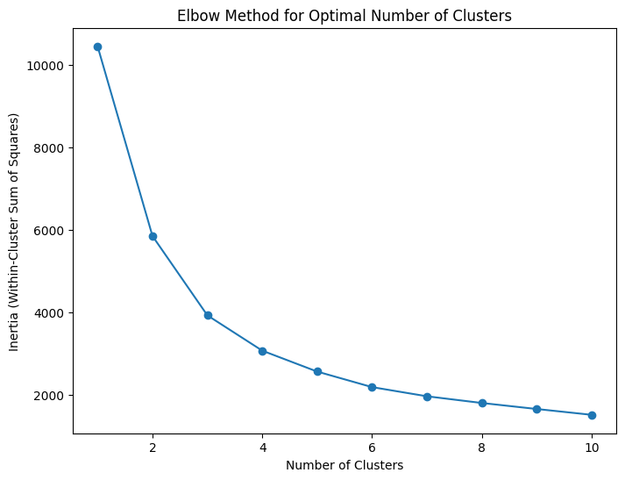
Note: The data and information in this document is reflective of a hypothetical situation and client. This document is to be used for KPMG Virtual Internship purposes only.
Model Development
Place any information about this point here.
K Means ++ Clustering
Cluster 2 is Highest revenue generating group of customers, so we will Try to understand characteristics of these customers.
K = 4

Slide 12
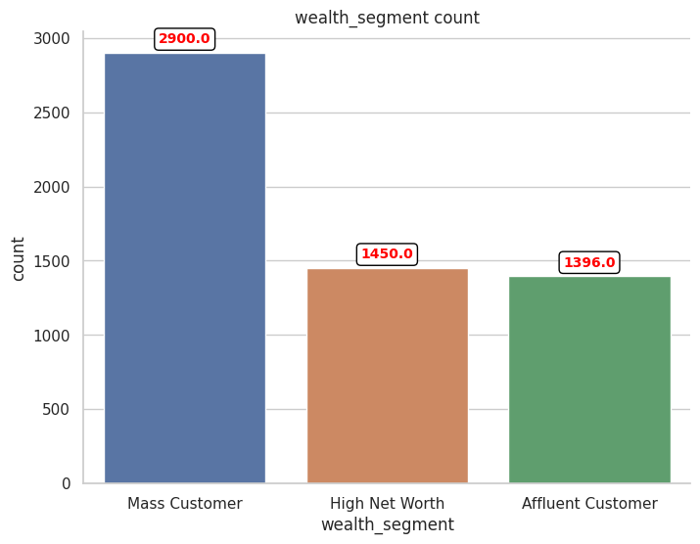
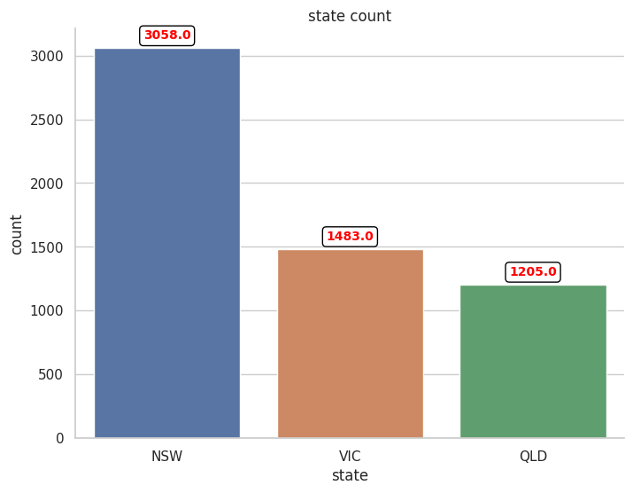
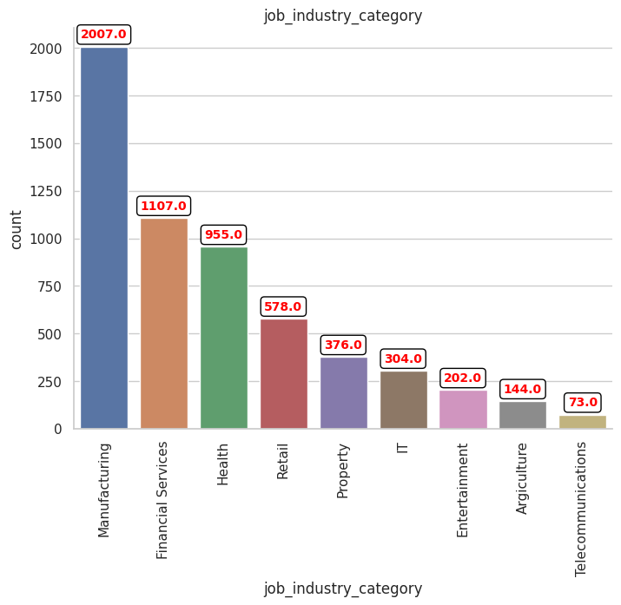
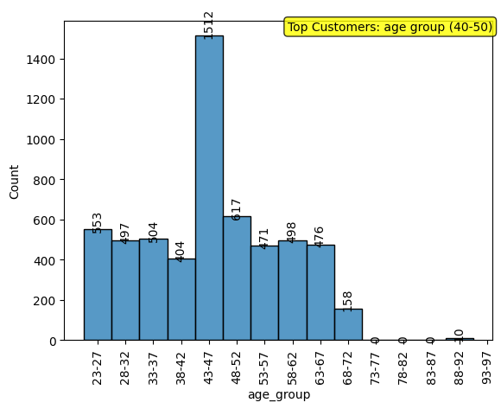
Note: The data and information in this document is reflective of a hypothetical situation and client. This document is to be used for KPMG Virtual Internship purposes only.
Interpretation
Cluster 2 Analysis - Target Customers Features:
`Mass Customers` From `NSW`
In (`Manufacturing` > `Financial Services` > `Health Care`) Job_Industry_Category
with age ranging from `40 - 50` as round figure.
Place any information about this point here.

Slide 13
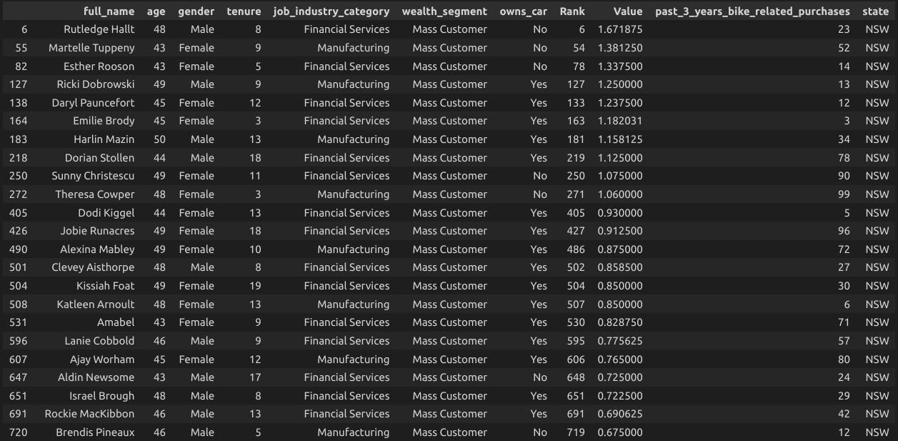
Note: The data and information in this document is reflective of a hypothetical situation and client. This document is to be used for KPMG Virtual Internship purposes only.
List of Target Customers from New Customers List
Appendix

Slide 14
Note: The data and information in this document is reflective of a hypothetical situation and client. This document is to be used for KPMG Virtual Internship purposes only.
Appendix
This is an optional slide where you may place any supporting items.
Data Sources : Data Provided from Client
Methodology : RFM Analysis for Customer Segmentation
Technical Details: K Means ++
Tech Used : Python, Pandas, Seaborn, Matplotlib, Scikit-Learn Library,
Power BI, Power Point.
Thank You !

